Slide 1















Education & Career Choices
By:
A Nimra Tabassum
Muhammed Rinief
Nishanth V Shetty
Suraiya Fathima
Syed Daeen

Slide 2













01
Motivation

Slide 3



Motivation
Why study education and career choices?
Career decision-making directly impacts future success.
Bridging the gap between skills, confidence, and career readiness.
“Education is not the filling of a pail, but the lighting of a fire.” – W.B. Yeats

Slide 4
02
Introduction

Slide 5




Introduction
Objective:
Scope:
To analyze how students make education and career choices.
To study factors like gender, confidence, skill alignment, and external influences.
Data from students aged 18–22.
Focus on gender-based trends, career paths, and decision-making.

Slide 6
03
Methodology

Slide 7






Methodology
Survey tool:
Data analyzed:
Tool for analysis:
Gender distribution.
Confidence levels.
Skill alignment.
Career influences and aspirations.
Microsoft Excel for data processing and chart creation.
Survey Tool: Google Forms.
Respondents: College students aged 18–22.

Slide 8




Work flow
Survey Creation
Data Collection
DAta Cleaning and Categorization
Analysis and Visualization
Insights Generation and Report Writing

Slide 9



Data Organization
Data Categories:
Demographics (gender, age).
Skill alignment.
Confidence levels.
Career aspirations and external influences.

Slide 10



04
Analysis

Slide 11
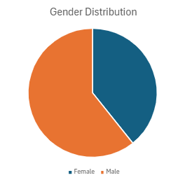
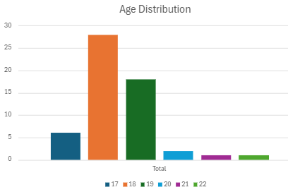


Gender & Demographics
Gender Ratio:
Males: 60%.
Females: 40%.
Age Distribution:
Majority of respondents are 18–19 years old.

Slide 12
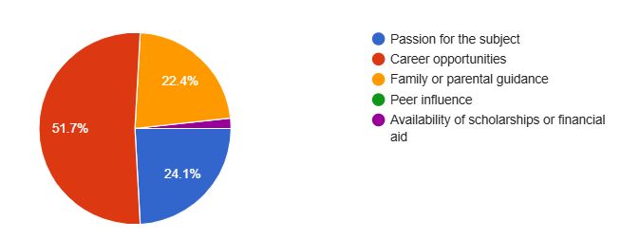
Career Influence
Factors Influencing Degree Choice:
Career Opportunities: 51.7%.
Passion for the Subject: 24.1%.
Family Guidance: 22.4%.

Slide 13
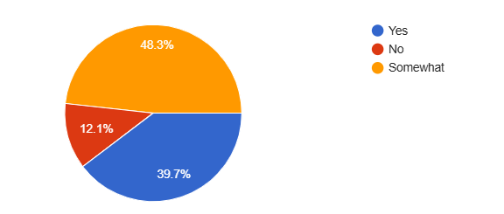
Skill Alignment
Skill Alignment Levels:
"Yes": 39.7%.
"Somewhat": 48.3%.
"No": 12.1%..

Slide 14
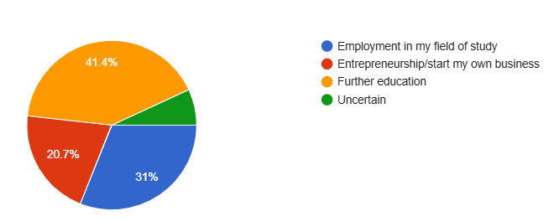
Carrer aspirations
Employment: 31%.
Further Education: 41.4%.
Entrepreneurship: 20.7%.

Slide 15
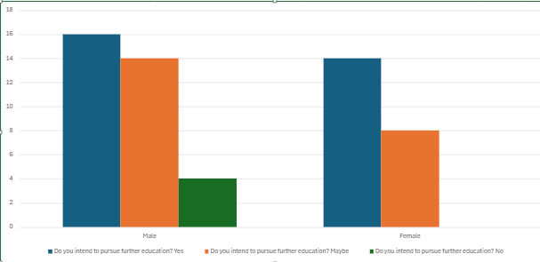
Gender and Education plans
Further Education Plans by Gender:
Females are more inclined toward
further education.

Slide 16
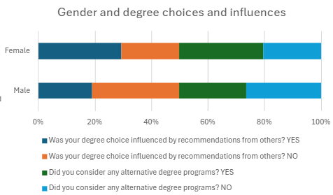
External influences
Role of External influence or
recommendations:
Females are more likely to consider
recommendations compared to males.

Slide 17
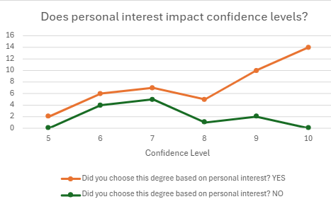
Confidence and Personal Interest
Students with personal interest in their field show higher confidence.

Slide 18





05
Inference & Key insights

Slide 19
Inference & Key insights
Insights from Skill Alignment
Students with aligned skills are more confident.
Insights from Gender Trends
Females prioritize further education; males are more flexible.

Slide 20
Recommendations
Introduce skill development workshops.
Provide career counseling tailored to trends.

Slide 21
Conclusion
Education and career choices depend heavily on skill alignment and confidence.
Addressing gaps can boost employability and satisfaction.

Slide 22



Thank You

